Slide 1
Covid 19 Resolving a Potential Crisis Presentation

Slide 2




Project analysis slide 2
Team Introduction
NITI PATEL
DEEP SHETA
https://github.com/niti2099
https://github.com/Deepsheta
https://www.linkedin.com/in/niti-patel-42a288167
https://www.linkedin.com/in/deep-sheta-5a79451a1/

Slide 3
Project analysis slide 2
Project Cycle
CLEAN DATA
PROJECT
PRESENT
FIND CORRELATION
ANALYSIS

Slide 4
Project analysis slide 3
Project
Background/Motivation
Life as we know it has been turned upside down due to the unprecedented circumstances brought on by covid-19.
As per The United States of America’s Gross Domestic Product (GDP), the US’s GDP decreased by 3.5 percent, In 2020, while the forecast initially was 2 percent GDP growth. [1]
Many businesses and industries across the world have been severely affected and the need for sustainable measures to help these industries to not just survive but thrive is greater than ever.

Slide 5
Project analysis slide 3
Project Analysis
We will try to provide governments, businesses, and organizations with insight on how to protect their economies and workforce in times of crisis, giving them the confidence and preparedness to brave any adversity thrown their way.
Problem Statement

Slide 6

Project analysis slide 3
Project Analysis
Our plan is to conduct an in-depth analysis of data sources and uncover the correlation between vaccine availability, unemployment levels, and GDP growth.
Through this analytics report, we will be able to pinpoint the fact that vaccination did help to recover from the economic instability.
Proposal

Slide 7
Project analysis slide 4
Project Flow
Tasks
Clean Data and Analyze it
How to avoid financial in-stability?
Business Objectives
Project Objectives
Implementation Plan
Schedules
As assign
How can government safe Gard the future crisis?
Government/
Organization Objectives
Resolve Potential Crisis
Analyze potential Data
Resources
Web sources

Slide 8
Exploratory
Data Analysis
Missing Values
In data exploration, there was 67 column which among which only 2 column was needed.
We also observed that many new vaccination were introduced over the period the name was unnecessary
All vaccination has value but as we needed the total so dropped all other columns
Invalid values
We observed that all 67 columns in vaccination dataset had counts but before introduction it was empty contenting zero (“0”) or no value

Slide 9
Data Cleaning
And
Transformation
Data Cleaning in Vaccination data sets
Deleted unnecessary column
Removed missing value
Sorted data set by date ascending order
Identify and remove outliers using Z-score method
Rename the date column to year_month
Data Transformation
Converted date column to date and time format
Reset the index of data frame
Added a new column for proportion of total population vaccinated
Data Cleaning in Unemployment data sets
Renaming the column for simplify
Removed/dropped any recorded having missing value

Slide 10
Data Cleaning
And
Transformation
Data Cleaning in Unemployment data sets
Renaming the column for simplify
Removed/dropped any recorded having missing value
Data Transformation
Convert the 'year_month' column to a datetime object
Data Cleaning in GDP data sets
Renaming date column to year and month
Removing NA and NAN value if available
Data Transformation
converting Date and month column to date and time format

Slide 11
Project analysis slide 3
Analysis Question
?
To what extent does vaccination affect unemployment rates?
To what extent does vaccination affect GDP rates?
What are some effective strategies to address economic crises during pandemics or lockdowns?
Questions

Slide 12
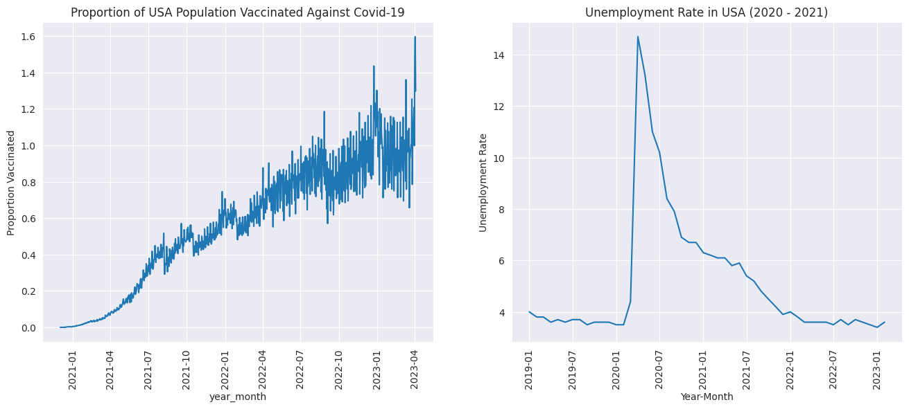
Analysis
To what extent does vaccination affect unemployment rates?

Slide 13
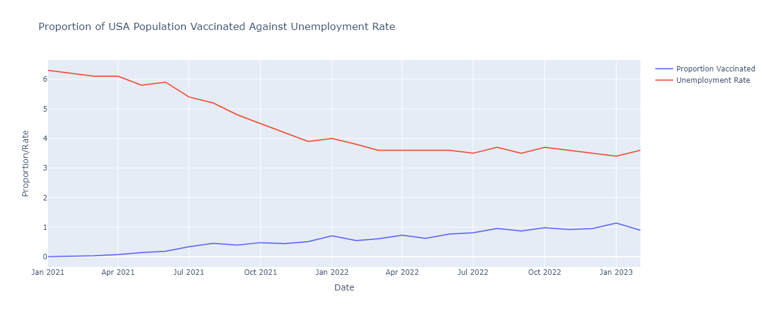
Analysis
To what extent does vaccination affect unemployment rates?

Slide 14
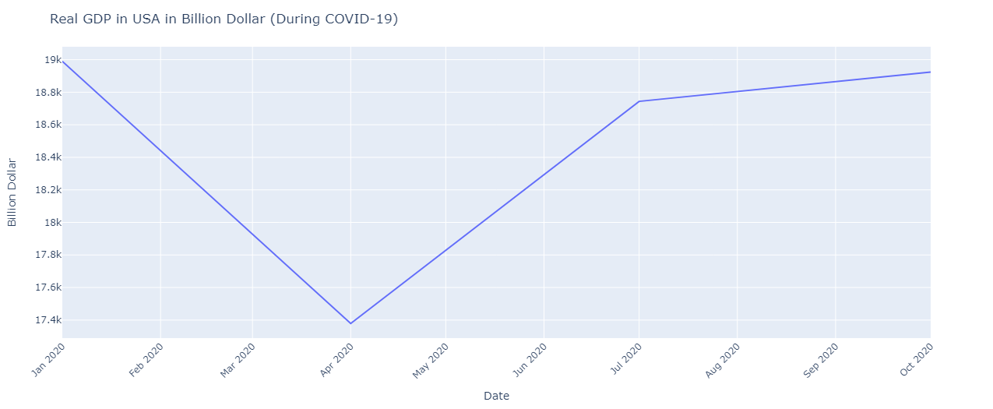
Analysis
GDP when Covid 19 hit.

Slide 15
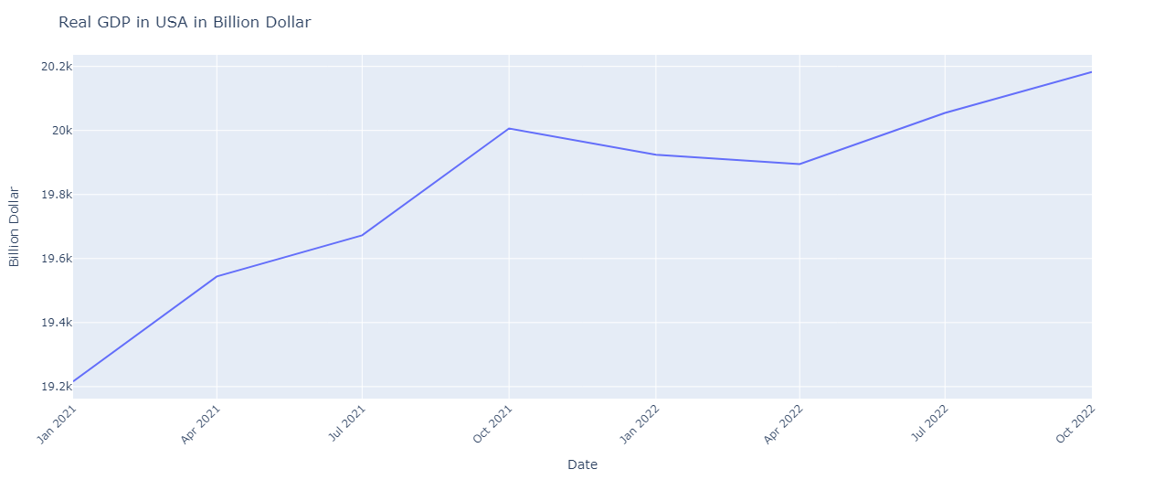
Analysis
To what extent does vaccination affect GDP rates?

Slide 16
What are some effective strategies to address economic crises during pandemics or lockdowns?
Targeted Financial assistance can be given by government to the people who are more affected by covid 19.
Spending more on health care can address both current health issue and increase economic growth.
By assisting other nations that are more adversely impacted by COVID, they can increase the amount of money that flows to their nation in the future because the nation receiving assistance will eventually be overflowing with them.

Slide 17
Data sources
Our World in Data is a website that provides data and research on a wide range of global issues, including health, education, poverty, and the environment.
https://ourworldindata.org/covid-vaccinations
The Bureau of Labor Statistics provided the dataset required to analyze the unemployment rate against covid 19
https://www.bls.gov/cps/data.htm
The Federal Reserve Economic Data (FRED) website provided the data base of USA’s GDP in Billions of dollar.
https://fred.stlouisfed.org/
References
[1] An official website of the United States government
https://www.bea.gov/news/2021/gross-domestic-product-4th-quarter-and-year-2020-advance-estimate
The line is mentioned under the paragraph of GDP for 2020

Slide 18
Project analysis slide 4
JIRA/Public Repository
https://analysis-project.atlassian.net/jira/core/projects/C1DAFRPC/summary?atlOrigin=eyJpIjoiYjA3NjgwYjAxODE4NDliYmI2MjE0Mzg0Zjc4NjViMjEiLCJwIjoiaiJ9
https://github.com/Deepsheta/Covid--19-descriptive-Analysis-for-resolving-a-potential-crisis
JIRA
GitHub
Project Plan
Data

Slide 19
Thank You

